Slide 1




Music Streaming Service
Developed Relational Database
Designed and Implemented in SQL
Presented by:
Nishita Kumbhar

Slide 2

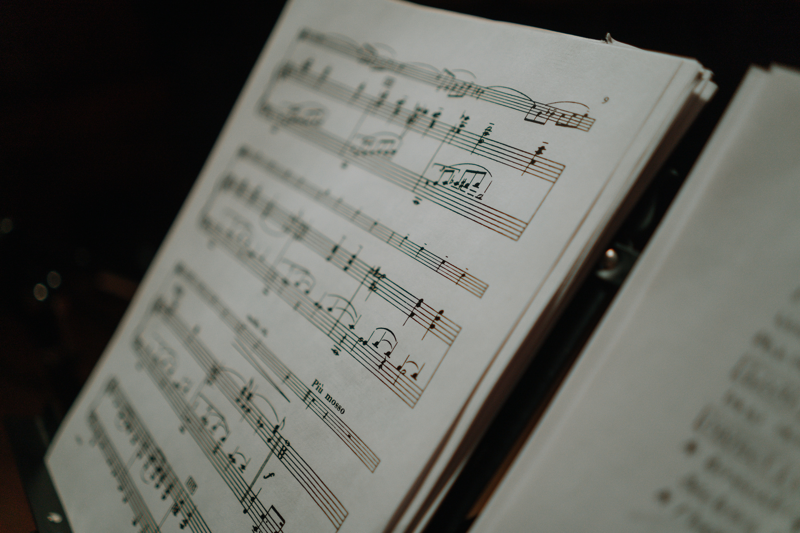
Abstract
ER Diagram
Structure of Table
Contents of Table
Contents
Subqueries
Joins
Views

Slide 3

Abstract
This Music Streaming Service database helps manage details of songs, artists, albums, listeners, and streaming history. It enables users to explore music, create playlists, and track listening behavior. SQL is used to store, retrieve, and analyze music-related data efficiently

Slide 4
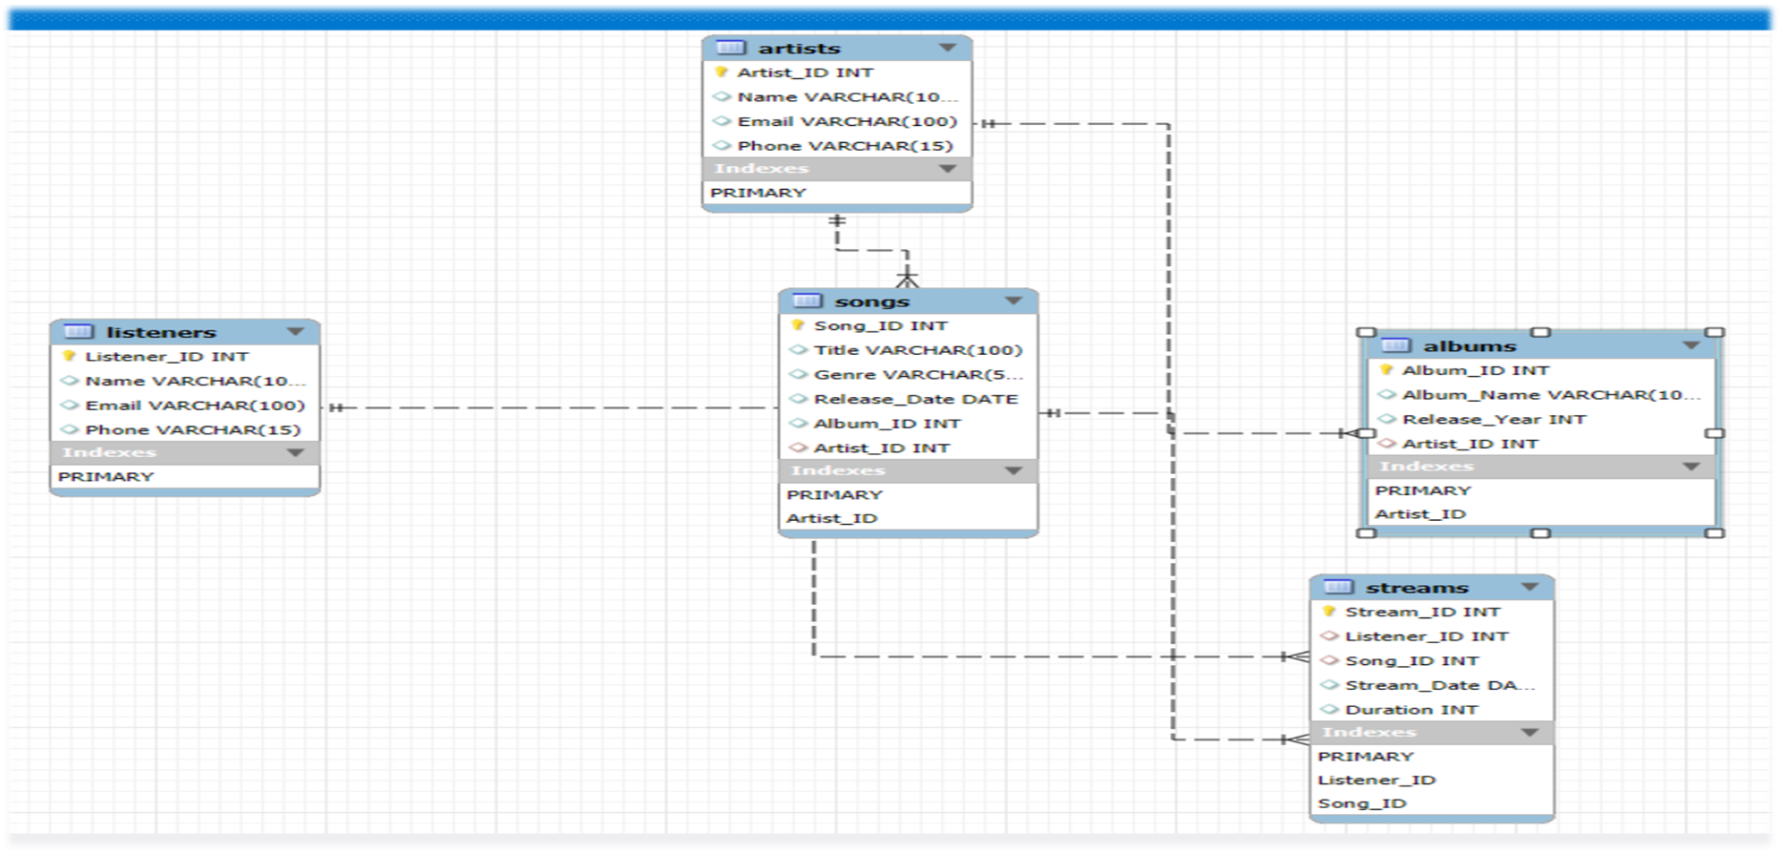
ER - Diagram
(Entity Relationship Diagram)

Slide 5
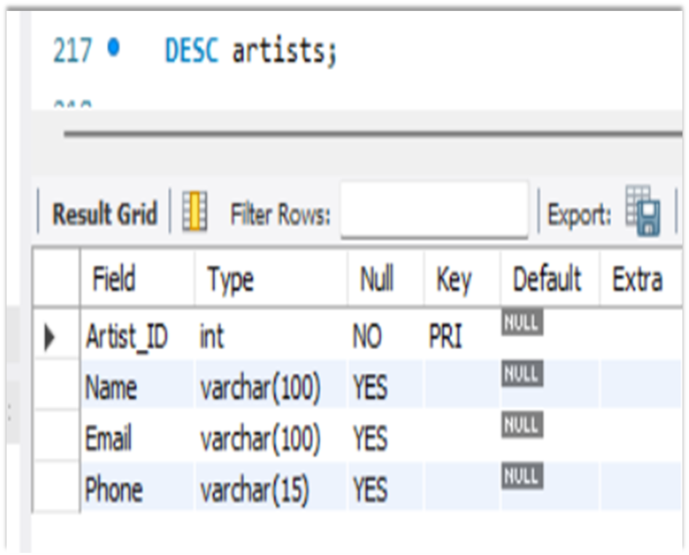
STRUCTURE OF TABLE
ARTISTS - TABLE
This table provide detail about the Artists .
It contains: Artists_Id, Name, Email , Phone.
Syntax : DESC ARTISTS;

Slide 6
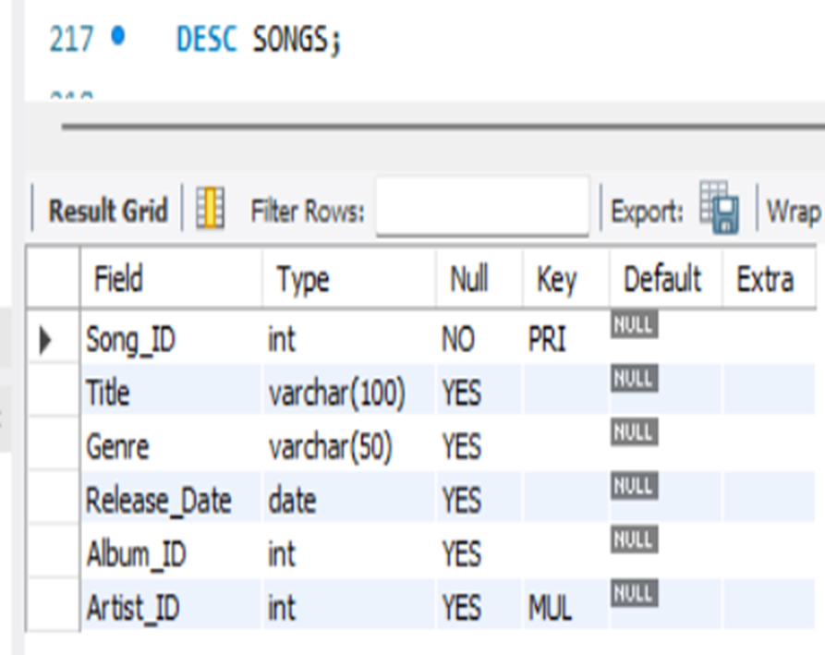
STRUCTURE OF TABLE
SONGS - TABLE
This table provide detail about the Songs .
It contains: Song_ID, Title,Genre , Relese_Date ,
Album_ID, Artist_ID.
Syntax : DESC SONGS;

Slide 7
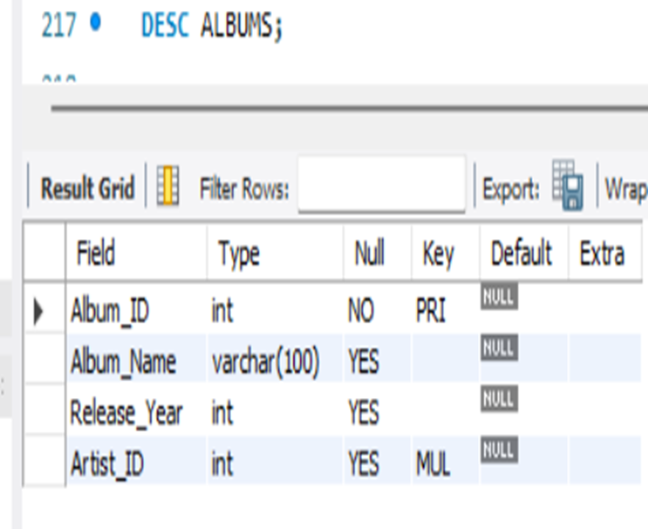
STRUCTURE OF TABLE
ALBUMS - TABLE
This table provide detail about the Albums .
It contains: Album_ID, Album _ Name, Release_Year , Artist_ID.
Syntax : DESC ALBUMS;

Slide 8
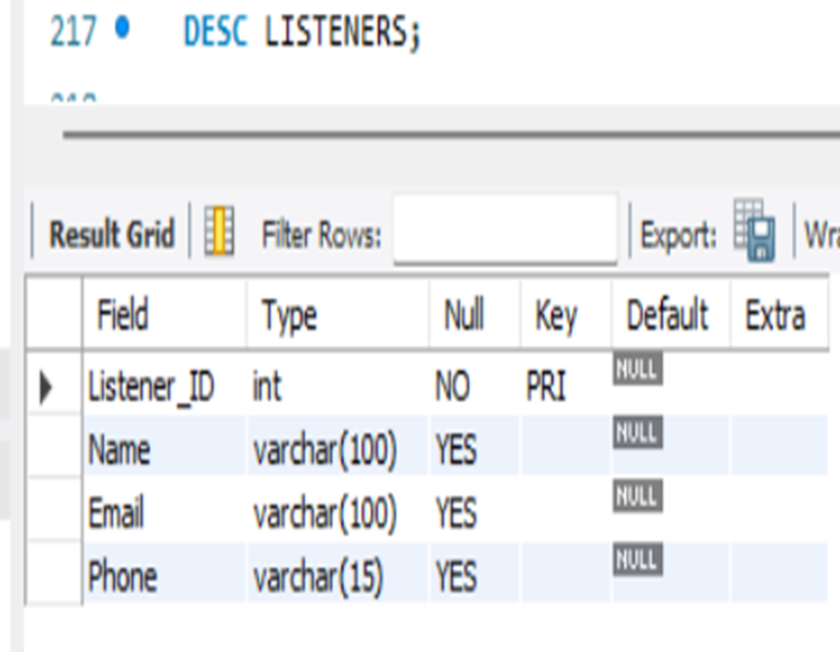
STRUCTURE OF TABLE
LISTENERS - TABLE
This table provide detail about the Listeners .
It contains: Listener_ID, Name, Email , Phone.
Syntax : DESC LISTENERS;

Slide 9
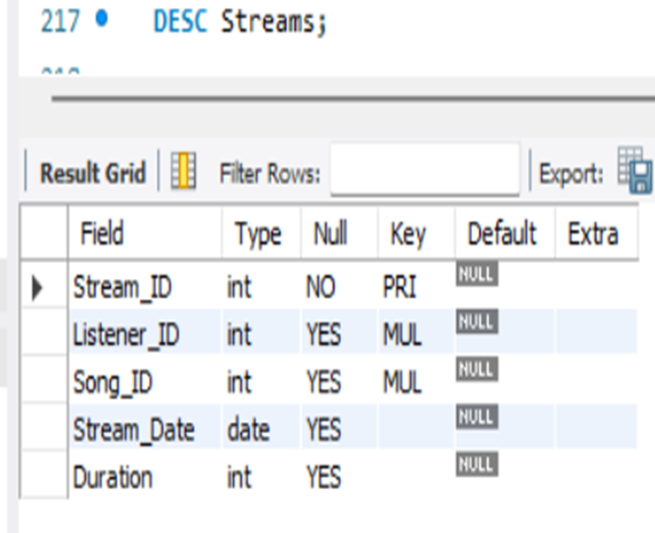
STRUCTURE OF TABLE
STREAMS - TABLE
This table provide detail about the Streams .
It contains: Stream_ID, Listener_id, Song_ID ,
Stream_Date, Duration.
Syntax : DESC STREAMS;

Slide 10
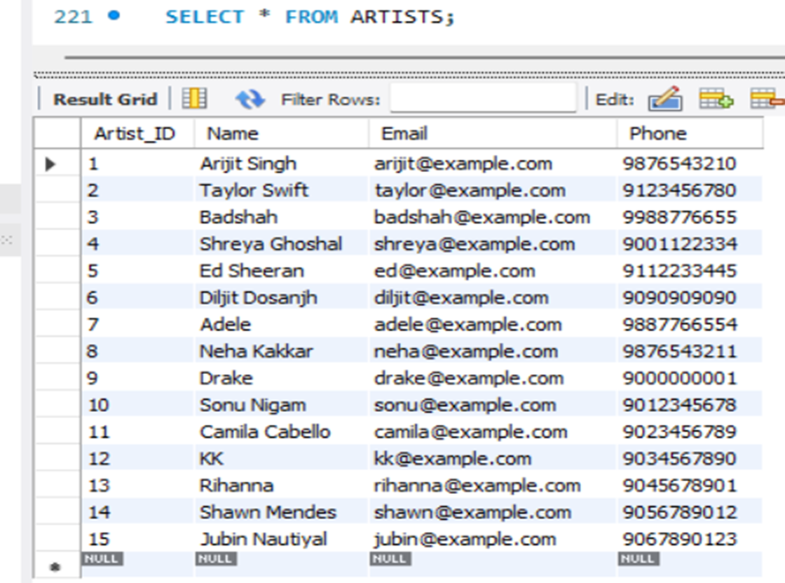
CONTENTS OF TABLE
ARTISTS - TABLE

Slide 11
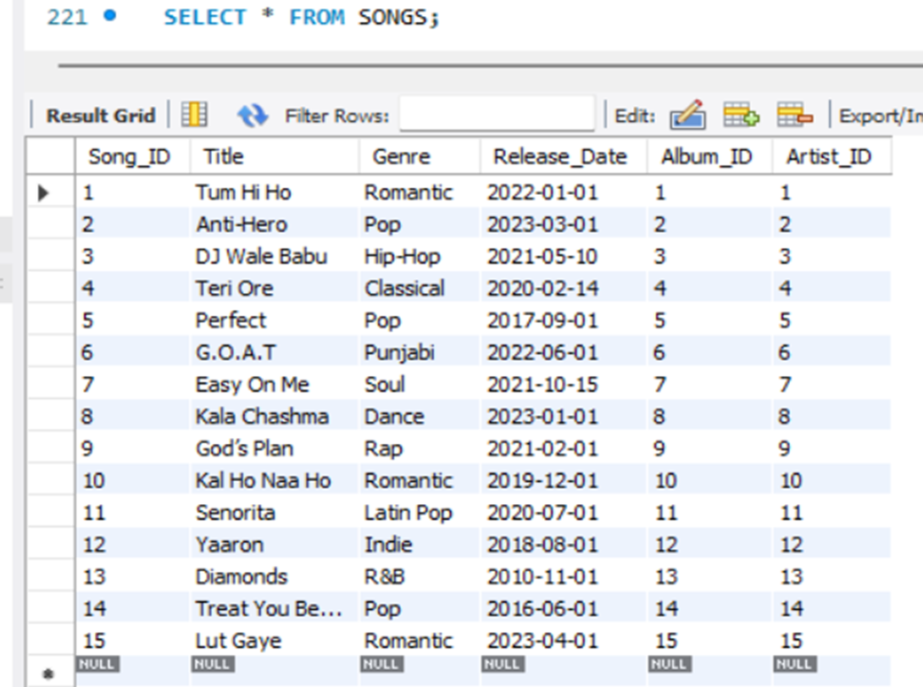
CONTENTS OF TABLE
SONGS - TABLE

Slide 12
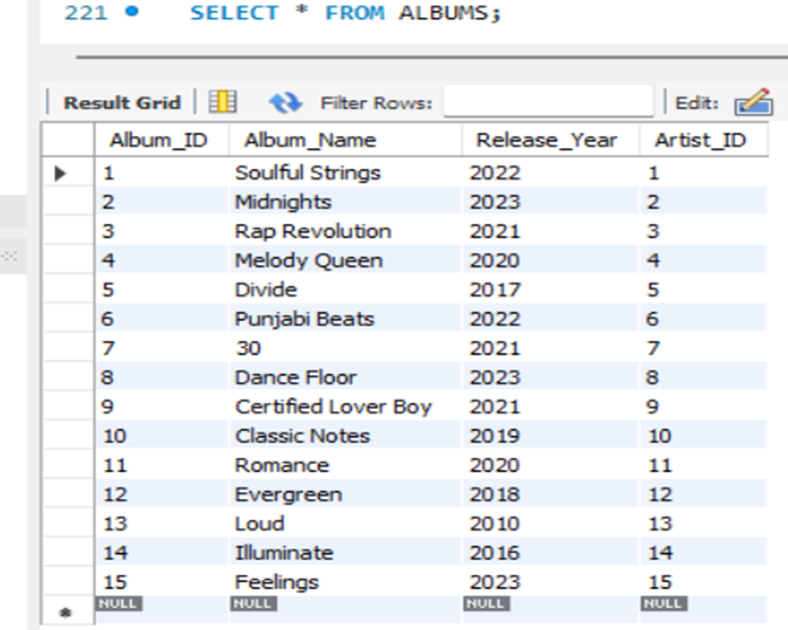
CONTENTS OF TABLE
ALBUMS - TABLE

Slide 13
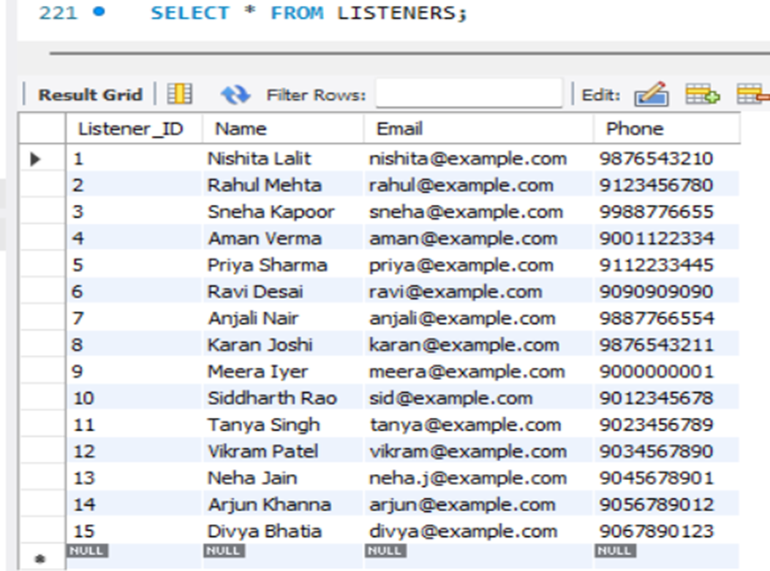
CONTENTS OF TABLE
LISTENERS - TABLE

Slide 14
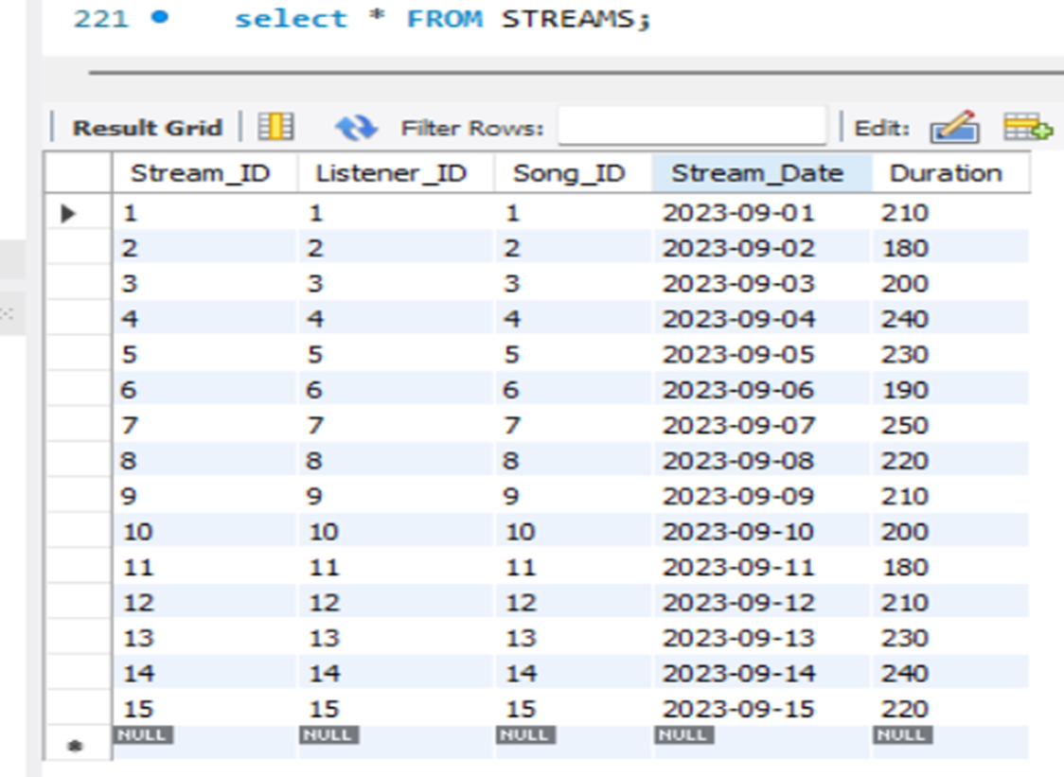
CONTENTS OF TABLE
STREAMS - TABLE

Slide 15
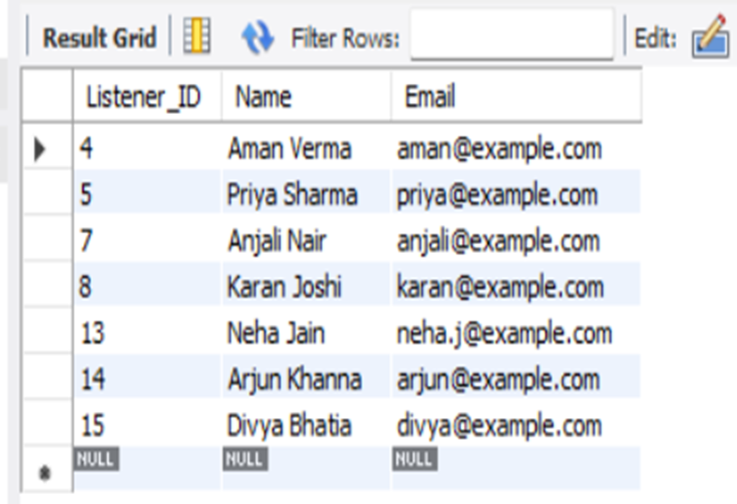
SUBQUERIES
1. List listeners who streamed songs longer than average duration
SYNTAX :
SELECT Listener_ID, Name, Email
FROM Listeners
WHERE Listener_ID IN (
SELECT Listener_ID
FROM Streams
WHERE Duration > (SELECT AVG(Duration) FROM Streams)
);

Slide 16
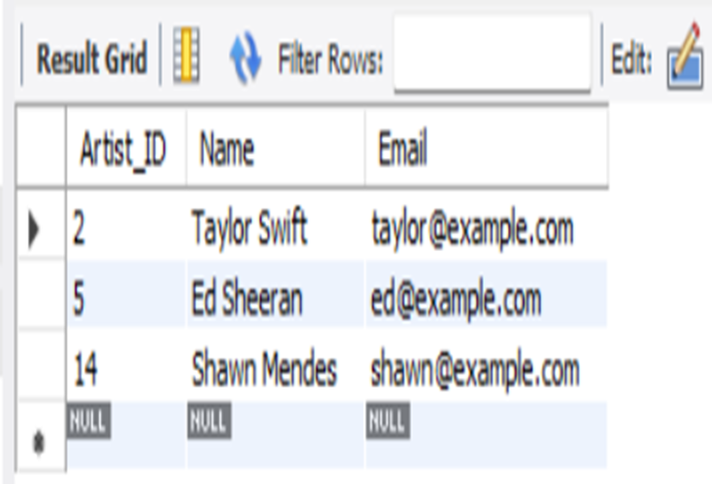
SUBQUERIES
2. Artists with songs in the "Pop" genre
SYNTAX :
SELECT Artist_ID, Name, Email
FROM Artists
WHERE Artist_ID IN (
SELECT Artist_ID
FROM Songs
WHERE Genre = 'Pop'
);

Slide 17
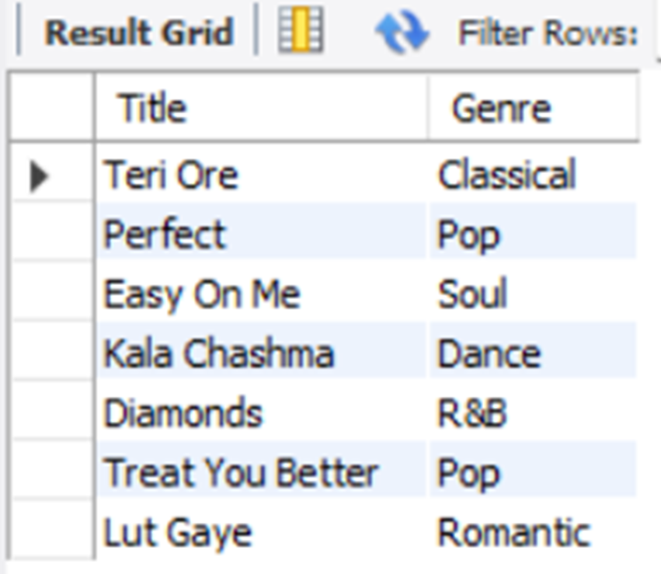
SUBQUERIES
3.Songs streamed longer than average duration
SYNTAX :
SELECT Title, Genre
FROM Songs
WHERE Song_ID IN (
SELECT Song_ID
FROM Streams
WHERE Duration > (SELECT AVG(Duration) FROM Streams)
);

Slide 18
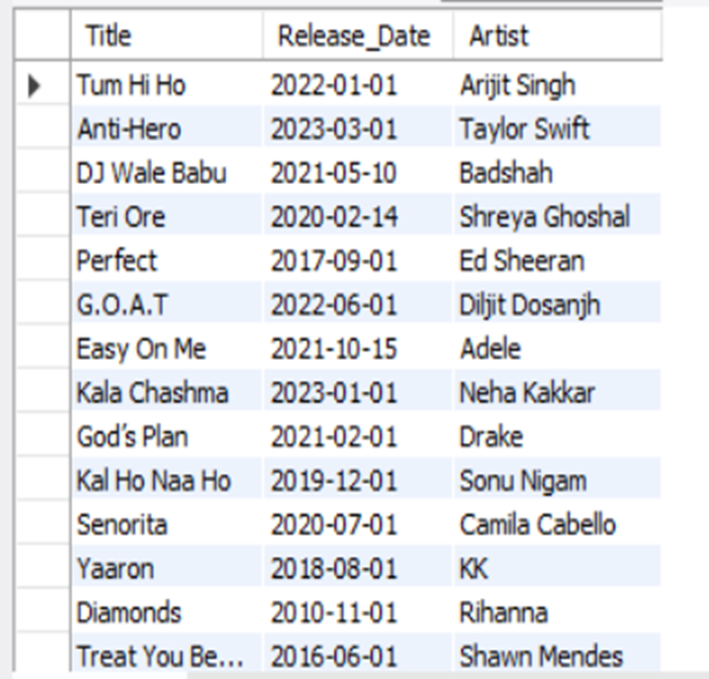
JOINS
1.Show songs with their artist names
SYNTAX :
SELECT s.Title, s.Release_Date, a.Name AS Artist FROM Songs s INNER JOIN Artists a
ON s.Artist_ID = a.Artist_ID;

Slide 19
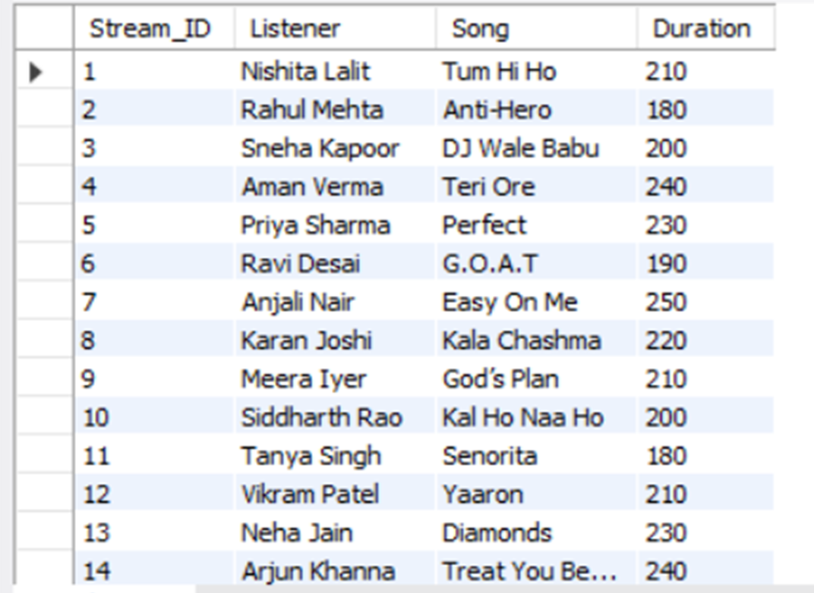
JOINS
2.Show streams with listener names and song titles.
SYNTAX :
SELECT st.Stream_ID, l.Name AS Listener, s.Title AS Song, st.Duration
FROM Streams st
INNER JOIN Listeners l ON st.Listener_ID = l.Listener_ID
INNER JOIN Songs s ON st.Song_ID = s.Song_ID;

Slide 20
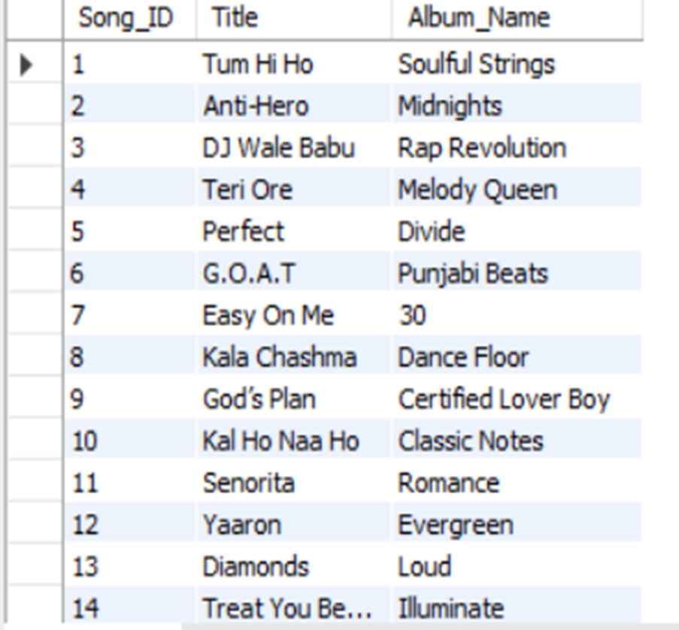
JOINS
3. List all songs and their albums (even if no album)
SYNTAX :
SELECT s.Song_ID, s.Title, a.Album_Name
FROM Songs s
LEFT JOIN Albums a ON s.Album_ID = a.Album_ID;

Slide 21
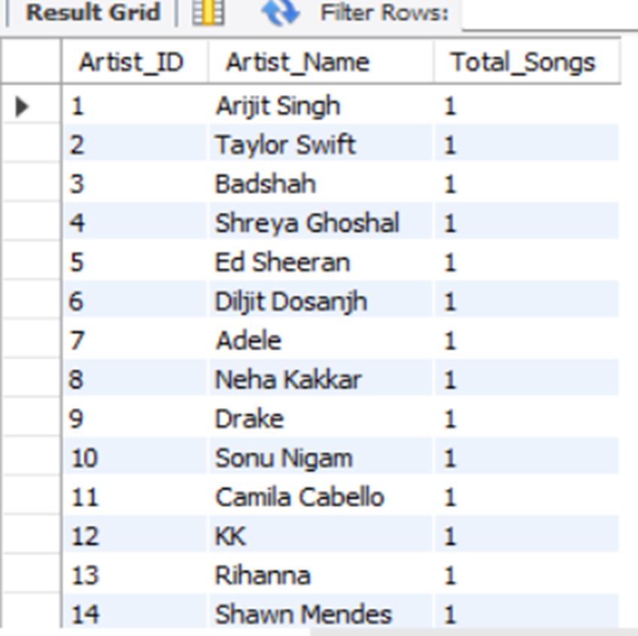
VIEWS
1.Number of Songs per Artists
SYNTAX :
CREATE VIEW Song Stream Stats AS
SELECT s.Song_ID, s.Title, COUNT(st.Stream_ID) AS Total_Streams
FROM Songs s
JOIN Streams st ON s.Song_ID = st.Song_ID
GROUP BY s.Song_ID, s.Title;

Slide 22
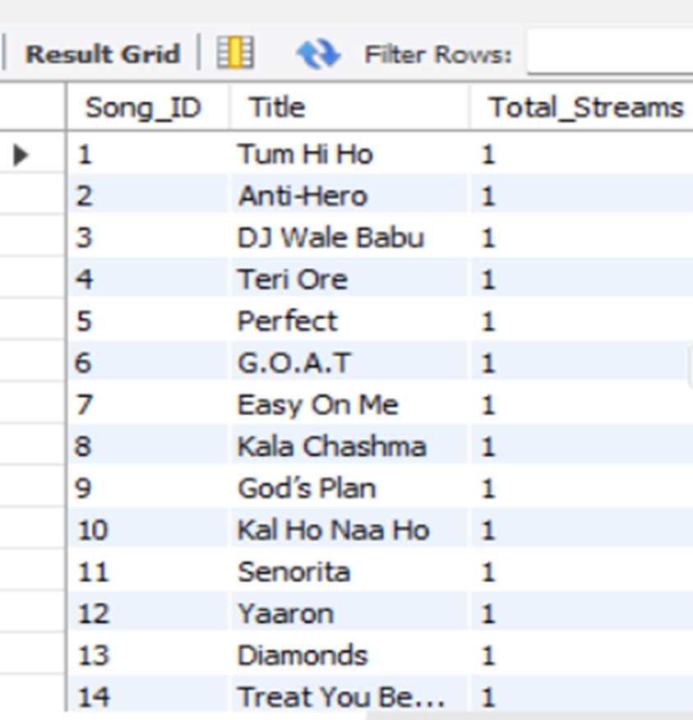
VIEWS
2. Create a view for total streams per song.
SYNTAX :
CREATE VIEW Song Stream Stats AS SELECT s.Song_ID, s.Title, COUNT(st.Stream_ID) AS Total_Streams FROM Songs sJOIN Streams st ON s.Song_ID = st.Song_IDGROUP BY s.Song_ID, s.Title;

Slide 23


Thanks
for scrolling along!

